Slide 1
Automatic Playlist Continuation
Million Playlist Dataset Challenge
COL764 Project
Team Stuxnet
Mudit Soni (2017EE10463)
Shivani Choudhary (2020SRZ8250)
Yash Malviya (2016CS50403)

Slide 2
CHALLENGE DESCRIPTION

Slide 3
About
Spotify MPD Challenge to enable research in music recommendation
Observed that playlists are replacing albums
Purpose (Focus, Workout)
Mood or theme (Sad, Motivating, Romantic)
Special occasions (Various festival/holidays)
Given a playlist of arbitrary length with some additional metadata, the task is to recommend upto 500 tracks that best fit the characteristics of the target playlist
COL764: Million Playlist Challenge
1
Team Stuxnet

Slide 4
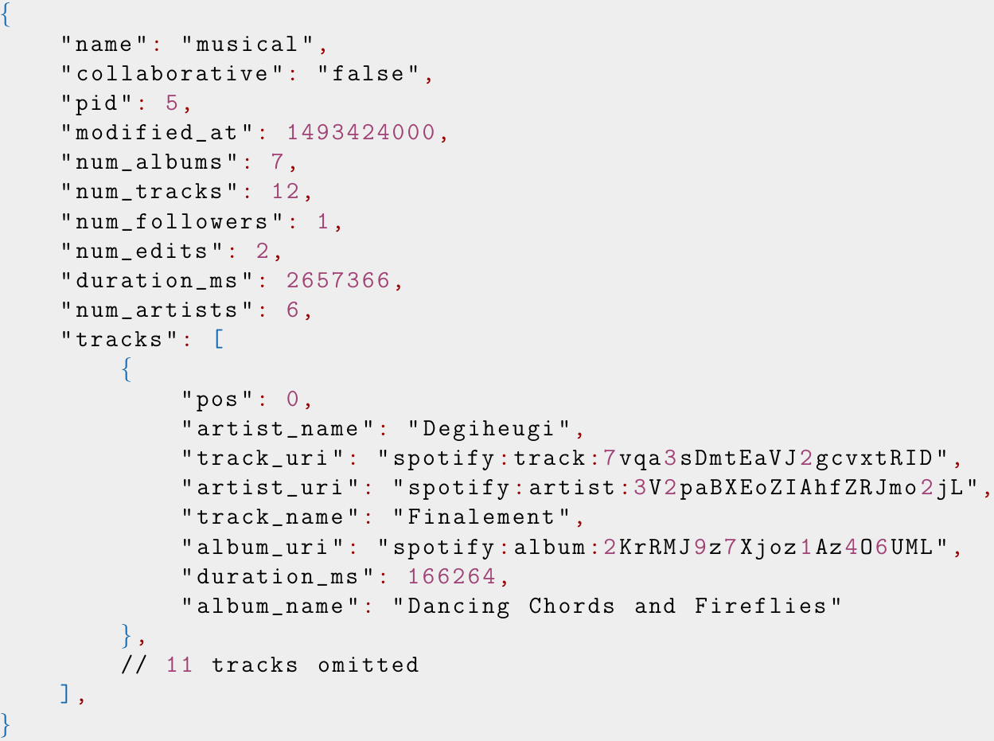
Dataset
1 million playlists created by users from Jan 2010 to Oct 2017
Included attributes shown on right
Test dataset had various scenarios like
Title only (Cold start problem)
First k (1, 5, 10, 25, 100) tracks
Random k (1, 5, 10) tracks
COL764: Million Playlist Challenge
2
Team Stuxnet

Slide 5





Metrics
Metrics
Dataset and Preprocessing
For the Evaluation of our project following metrics were used:
R-precision: Ratio of number of common tracks in recommended and ground truth set and number of tracks in ground truth set. Higher the better.
Normalized Discounted Cumulative Gain: Relevant docs should appear earlier. Higher the better.
Recommended songs clicks: If 10 song recommended at once, number of refreshes required to get first click from user. Lower the better.
COL764: Million Playlist Challenge
3
Team Stuxnet

Slide 6
TECHNICAL OUTLINE

Slide 7
Data Augmentation and Preprocessing
Dataset and Preprocessing
Additional track information fetched using Spotify API [2]
Acousticness, Danceability, Energy, Instrumentalness, Liveness, Speechiness, Valence, Tempo
Sparse matrices from scipy to store playlist-track, track-feature, playlist-feature matrices
Tokenization for cold start problem
COL764: Million Playlist Challenge
4
Team Stuxnet

Slide 8
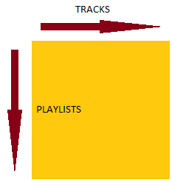


Collaborative Filtering
Dataset and Preprocessing
Item-item collaborative filtering used, with tracks as items.
Playlist-Track Matrix normalized with BM25.
Similarity between tracks defined as dot product of PTM columns.
The score for a track i in playlist u is obtained as
Scores obtained for each playlist in test set and top n tracks selected.
Based on team Creamy Fireflies[3] approach.
COL764: Million Playlist Challenge
5
Team Stuxnet

Slide 9
Content-based Filtering
Dataset and Preprocessing
Item-item collaborative filtering used, with tracks and playlist as items.
First Track vs Features (Album id, Artist, PCA of Augmented feature BM25 score normalized separately) and playlist vs feature matrix are generated.
Track pairwise similarity matrix was generated.
Similarity between tracks defined as dot product of Track and feature columns.
S_{ij} = f_{i} * f_{j}
The score for a track i in playlist u is obtained as:
Scores obtained for each playlist in test set and top n tracks selected.
Tracks
Tracks
Playlist
Tracks
COL764: Million Playlist Challenge
6
Team Stuxnet

Slide 10
RESULTS AND DISCUSSION

Slide 11
Collaborative Filtering
Metrics
Dataset and Preprocessing
Only average results are provided over different scenarios.
Metric (Average) | Score
R-precision | 0.044
nDCG | 0.072
Song Clicks | 2.199
COL764: Million Playlist Challenge
7
Team Stuxnet

Slide 12
Content-based Filtering
Scenario | nDCG | R-precision | Song clicks
First Track | 0.071276 | 0.047096 | 18.063492
First 5 Track | 0.106833 | 0.073384 | 5.222222
First 10 Track | 0.114567 | 0.083276 | 4.301587
First 25 Track | 0.114121 | 0.047972 | 7.174603
First 100 Track | 0.088319 | 0.046226 | 16.650794
Random Track | 0.085608 | 0.048311 | 14.444444
Random 5 tracks | 0.164061 | 0.122356 | 4
10 Random Tracks | 0.209539 | 0.157594 | 1.253968
Title only (Partial match) | 0.009237 | 0.004268 | 31.539683
Title only (Full) | 0.000283 | 0.000098 | 20.555556
Average Score | 0.096384 | 0.063058 | 12.320635
COL764: Million Playlist Challenge
8
Team Stuxnet

Slide 13
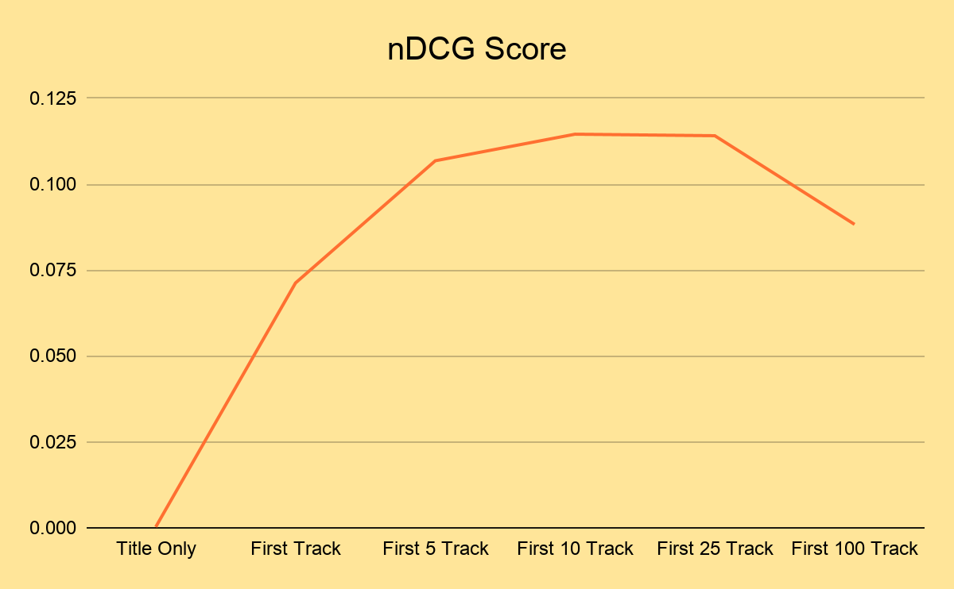
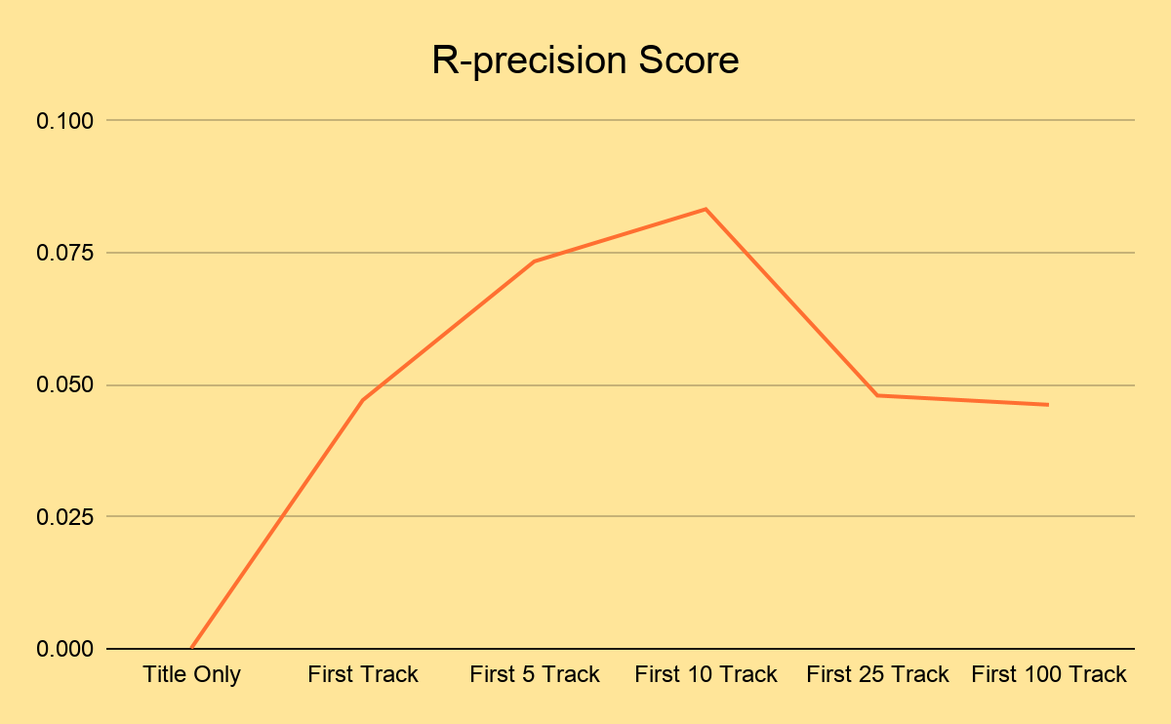
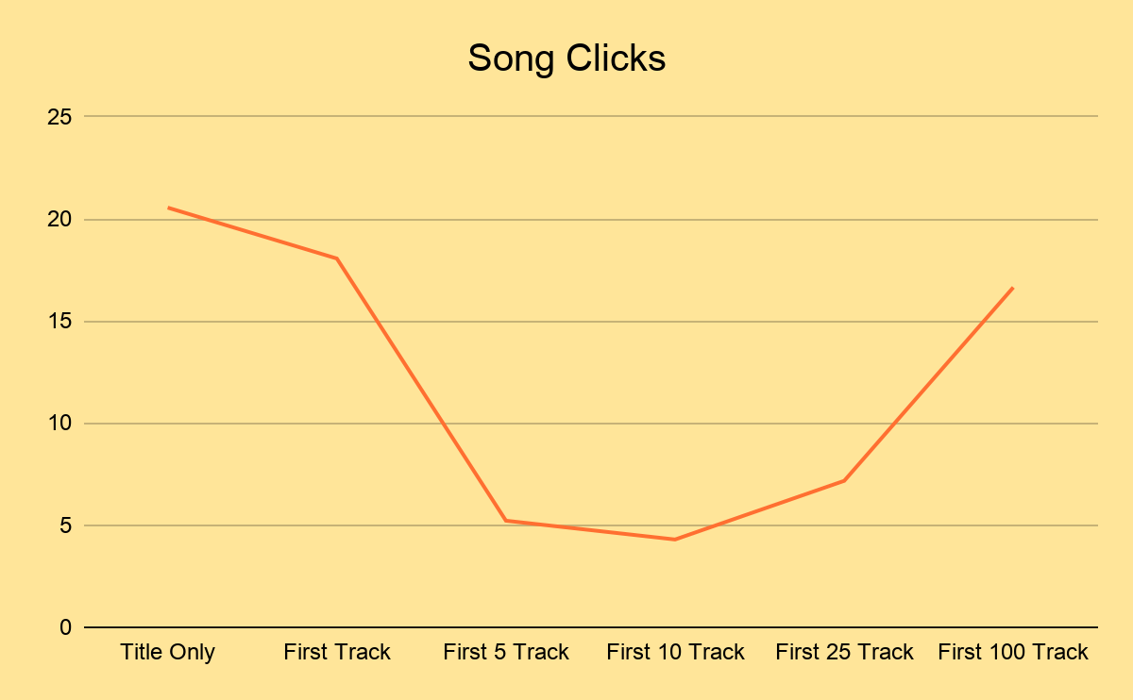
Content-based Filtering
COL764: Million Playlist Challenge
9
Team Stuxnet

Slide 14
Optimization and nDCG
Metrics
Dataset and Preprocessing
Under this, weights of Album feature, Artist feature and PCA weights are weighted and parameter search using random grid space search applied using hyperopt package for first 1-25 track cases
The best for each category:
Scenario | wfeat | walbum | wartist | ndcg | nDCG(equal weight)
First Track | 1.369839 | 4 | 2 | 0.076662 | 0.071276
First 5 Track | 2.534933 | 4 | 3 | 0.108748 | 0.106833
First 10 Track | 1.021825 | 4 | 4 | 0.119422 | 0.114567
First 25 Track | 1.752758 | 4 | 4 | 0.123541 | 0.114121
First 100 Track | 0.116066 | 4 | 4 | 0.096103 | 0.088319
COL764: Million Playlist Challenge
10
Team Stuxnet

Slide 15
Comparison with State-of-Art
Metrics
The best approach in ACM RecSys Challenge 2018 was by team vl6 [4].
Team vl6 used 2-stage model, WRMF collaborative-filtering, followed by XGBoost. Cold start was separately handled.
Scenario | Stuxnet |  |  | vl6
 | nDCG | R-Precision | Clicks | nDCG | R-Precision | Clicks
Title Only | 0.000283 | 0.000098 | 20.555556 | 0.2044 | 0.0979 | 10.746
First Track | 0.071276 | 0.047096 | 18.063492 | 0.3065 | 0.1497 | 3.527
First 5 Track | 0.106833 | 0.073384 | 5.222222 | 0.3773 | 0.2032 | 0.889
First 10 Track | 0.114567 | 0.083276 | 4.301587 | 0.3978 | 0.2094 | 0.439
First 25 Track | 0.114121 | 0.047972 | 7.174603 | 0.4006 | 0.2485 | 0.265
First 100 Track | 0.088319 | 0.046226 | 16.650794 | 0.3523 | 0.1869 | 0.636
COL764: Million Playlist Challenge
11
Team Stuxnet

Slide 16
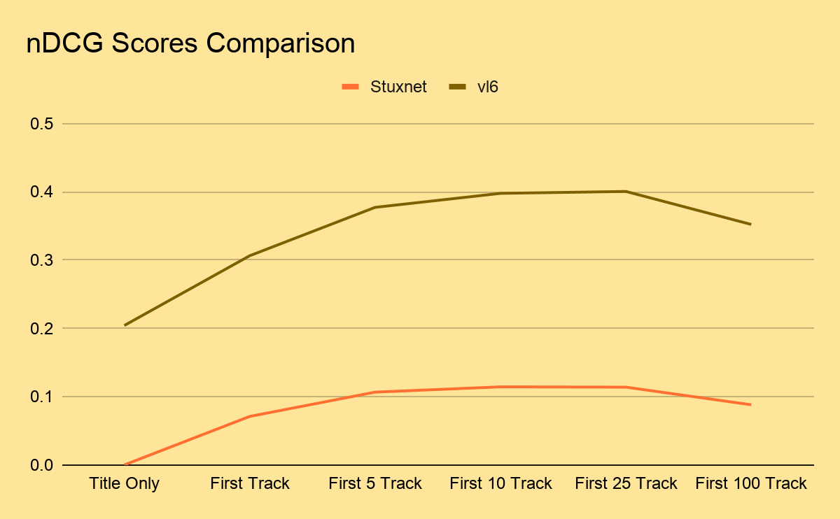
Comparison with State-of-Art
The comparison between nDCG scores of the two approaches is given in chart:
COL764: Million Playlist Challenge
12
Team Stuxnet

Slide 17
Conclusion and Future Directions
We have tried different techniques: collaborative, content-based filtering, NN approach for sub-task.
We observed content-based filtering gave best results and have compared it with state of the art.
Steps could be taken to improve our recommender.
Next steps:
To use an ensemble of different approaches.
Try black-box approaches for tasks or sub-tasks.
COL764: Million Playlist Challenge
13
Team Stuxnet

Slide 18
References
[1] Hamed Zamani and Markus Schedl and Paul Lamere and Ching-Wei Chen. An Analysis of Approaches Taken in the ACM RecSys Challenge 2018 for Automatic Music Playlist Continuation.
[2] Spotify API: https://developer.spotify.com/documentation/web-api
[3] S. Antenucci, S. Boglio, E. Chioso, E. Dervishaj, S. Kang, T. Scarlatti, and M. F. Dacrema. Artist-driven layering and user’s behaviour impact on recommendations in a playlist continuation scenario. In Proceedings of the 2018 ACM Recommender Systems Challenge, RecSys Challenge ’18, Vancouver, BC, Canada, 2018.
[4] M. Volkovs, H. Rai, Z. Cheng, G. Wu, Y. Lu, and S. Sanner. Two-stage model for automatic playlist continuation at scale. In Proceedings of the 2018 ACM Recommender Systems Challenge, RecSys Challenge ’18, Vancouver, BC, Canada, 2018.
[5] Challenge, Dataset, Metrics Description: https://www.aicrowd.com/challenges/spotify-million-playlist-dataset-challenge
COL764: Million Playlist Challenge
14
Team Stuxnet

